Slide 1






INTERNET OF THINGS [CS373]
CURBING CROWD SIZE
PREPARED BY:
RUTIKA MEHTA (18DCS045)
VARADA NAIR (18DCS052)
MANSI NAKRANI (18DCS053)
GUIDED BY:
PROF.SHIVAM RIBADIYA
PROF.NILESH DUBEY

Slide 2


1
DEFINITION
  The World Health Organization, WHO, has advised people to stay away from crowded places to protect themselves from the spread of Coronavirus disease. Even though people practice social distancing, it may not be effective when they are present in crowded places.
  Hence, we developed an application using Arduino Uno and added resources that counts the number of people in a given area and controls the crowd.

Slide 3



2
TOOLS & TECHNOLOGY
  Tinkercad :
    Arduino UNO
    Breadboard
    PIR sensor
    16 x 2 Backlight LCD
    SG90 Micro-Servo motor
    Jumper wires
    Potentiometer
    Resistor

Slide 4
3
IMPLEMENTATION OF THE SYSTEM
  If a person is going to enter the building, he/ she can wave or hover his/ her hand over the PIR sensor module.
  The PIR tracking sensor module, will send a LOW signal to the Arduino Uno microcontroller and the value will be stored in counter.
  If the value stored in the counter reaches the maximum occupancy value, the LCD display module will display that the entry is prohibited and the door will remain closed until someone leaves the building.

Slide 5
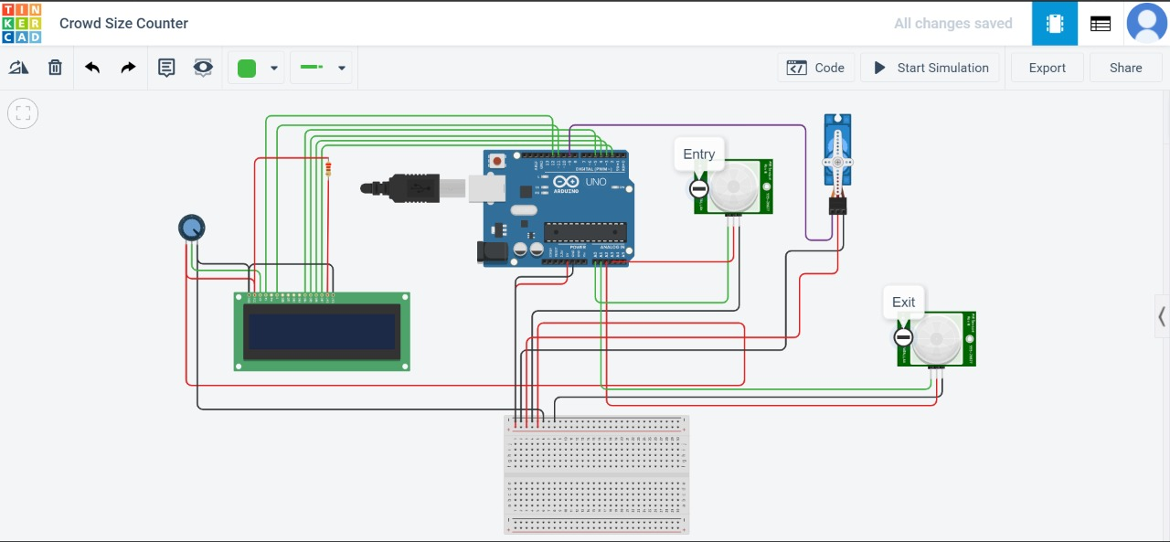
4
CIRCUIT DIAGRAM

Slide 6
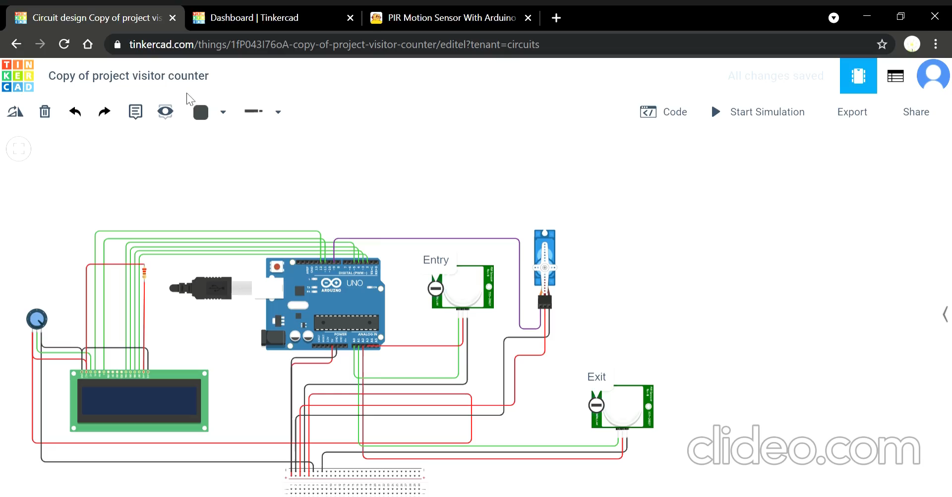
5
IMPLEMENTATION

Slide 7


6
FUTURE WORK
  The application can be made as alert operators in risky environments.
  The system can be enhanced by installing industrial PIR sensors which have better sensitivity at detecting persons at sufficient distance.
  The data can be sent to cloud and store it for future use.
  The data can also be monitored live for security purposes and can be used for further IoT applications.

Slide 8


7
CONCLUSION
The system is simulated using TinkerCad. The project uses two PIR sensors and servo motor. Arduino helps achieve the coordination among the sensors and motor.
The system is designed to use at places like laboratories or classrooms where the intensity of crowd is intermediate.

Slide 9


8
THANK YOU

